Slide 1


CSI 1430 - Professor John
PRACTICUM PASSERS: GROUP PROJECT N4.G3
Present by Nolan Schirripa, Christine Seng, Erick Martinez, Georgia Rushing, Graham Balas

Slide 2


CORE
FEATURES

Slide 3
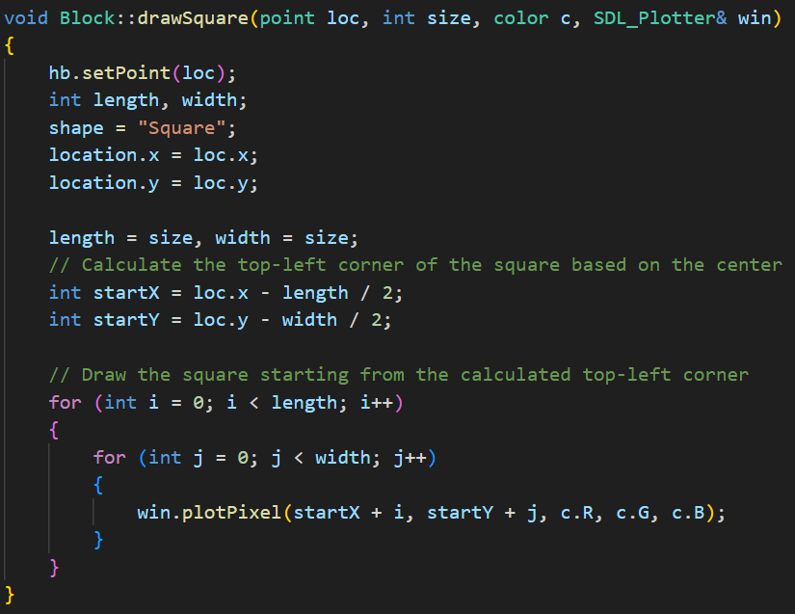
DRAWING
SHAPES (SQUARE)

Slide 4
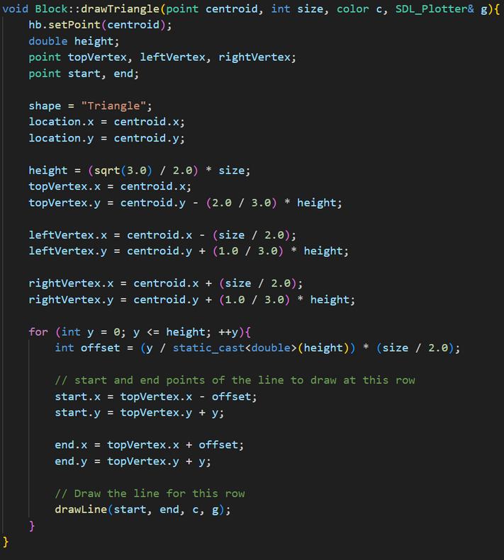
DRAWING
SHAPES (TRIANGLE)

Slide 5
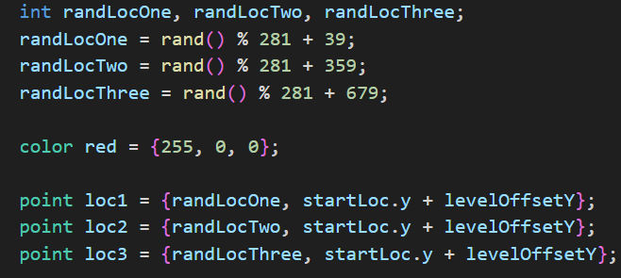
RANDOM BLOCK
LOCATIONS

Slide 6
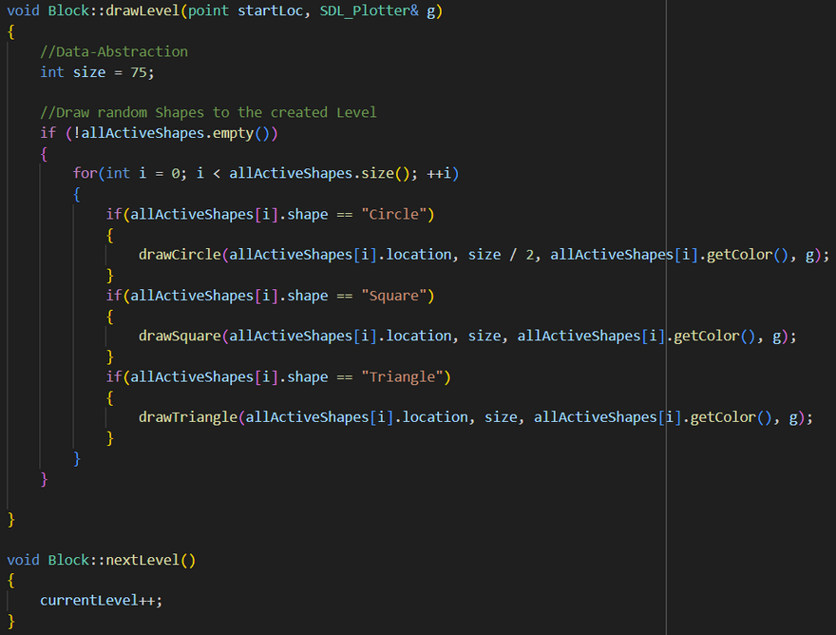
DRAWING
LEVELS

Slide 7
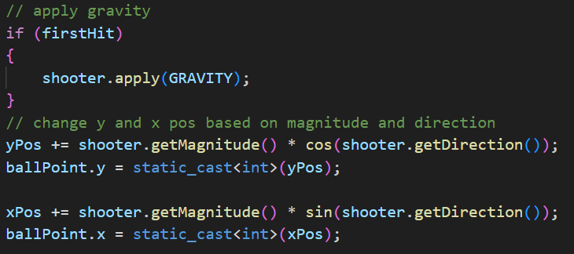
BALL PHYSICS (FALLING)

Slide 8
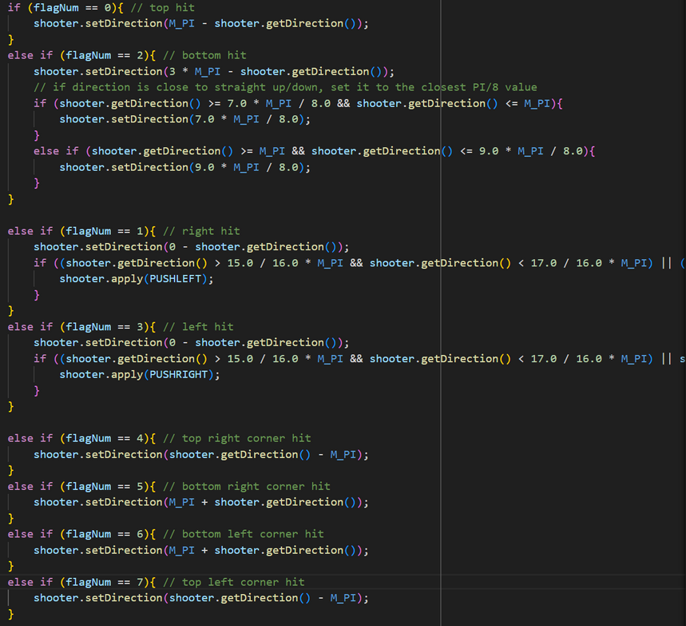
BALL PHYSICS (BOUNCING)

Slide 9
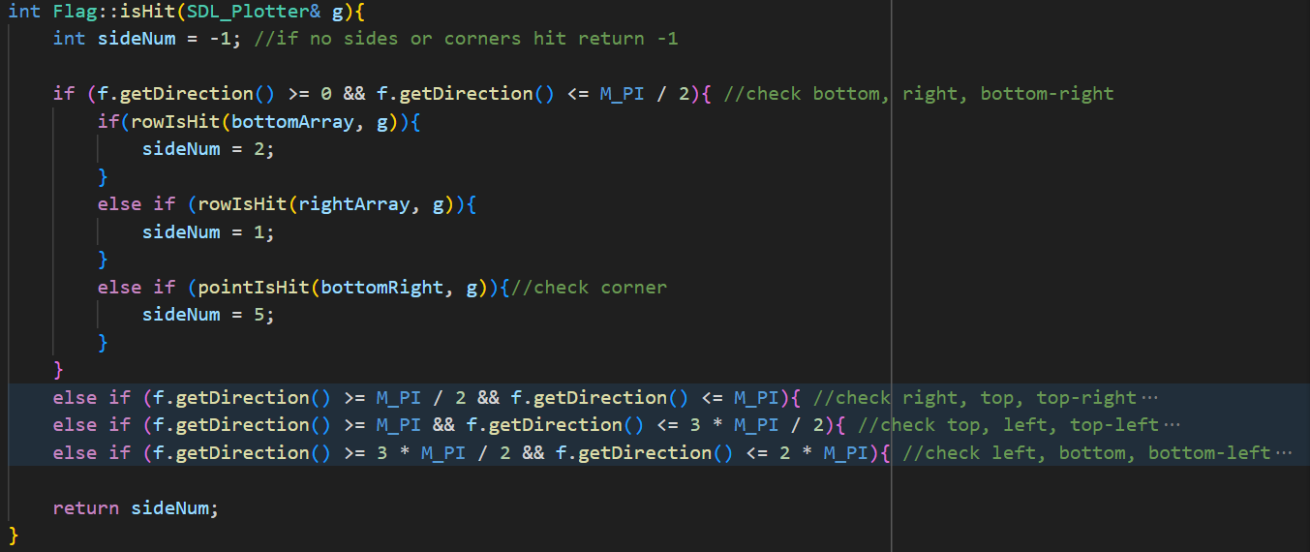
BALL + BLOCK
COLLISIONS (FLAGS)

Slide 10
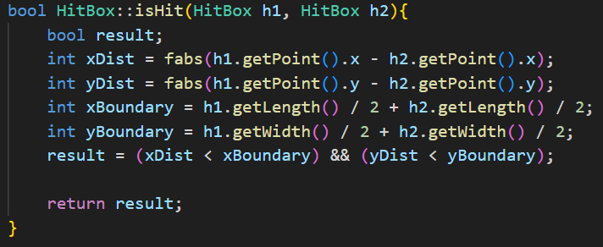
BALL + BLOCK
COLLISIONS (HITBOXES)

Slide 11
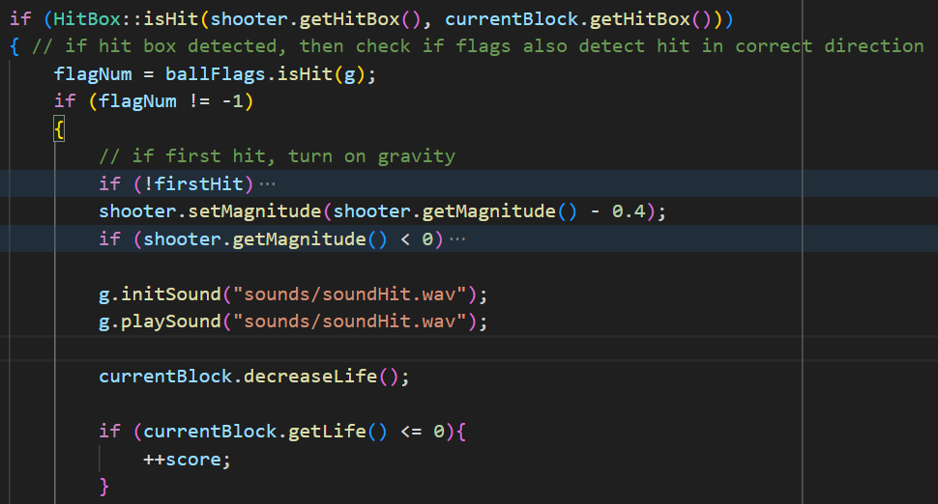
BALL + BLOCK
COLLISIONS (HITBOXES)

Slide 12
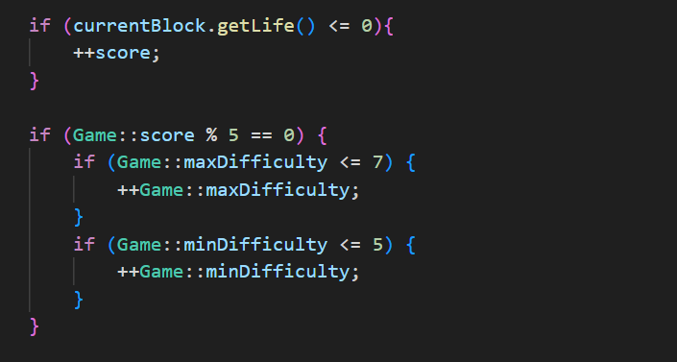
SCORE +
LEVEL DIFFICULTY

Slide 13
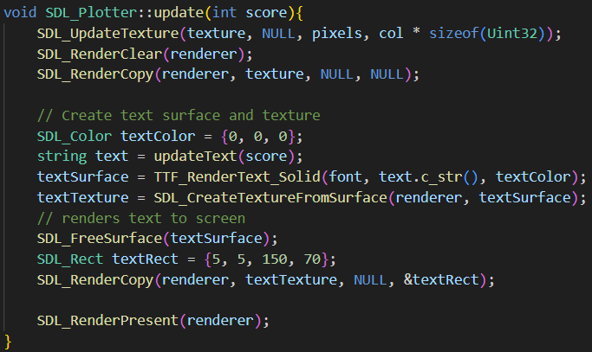
TEXT/TTF
(TRUETYPE FONT)

Slide 14
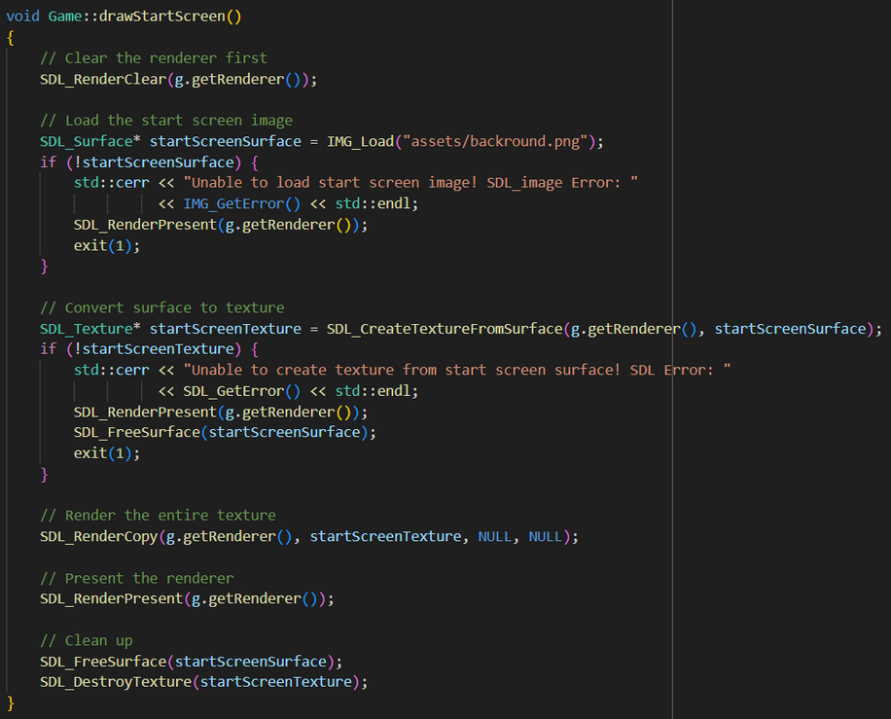
IMAGES
(SDL IMAGE)

Slide 15
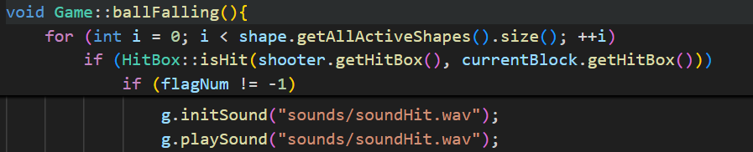
SOUNDS
(SDL MIXER)

Slide 16
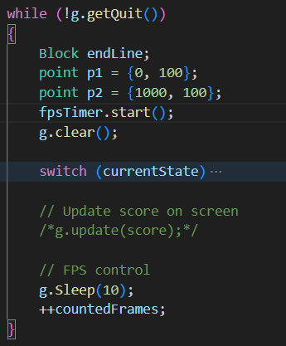
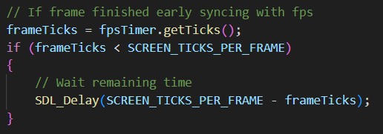
FPS

